Slide 1
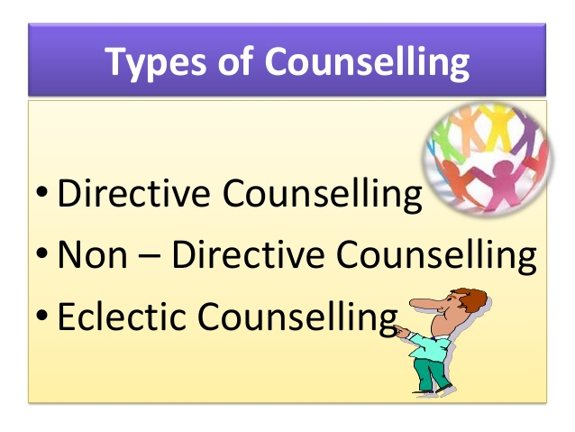

Slide 2
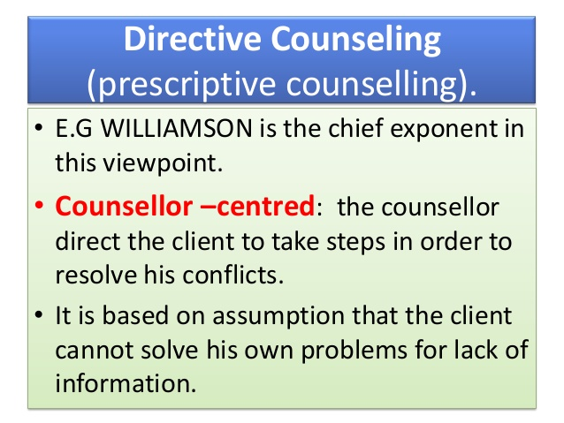

Slide 3
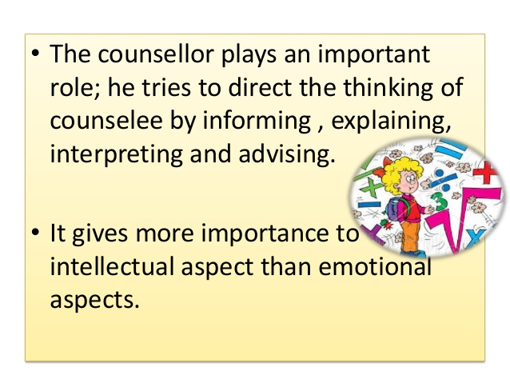

Slide 4
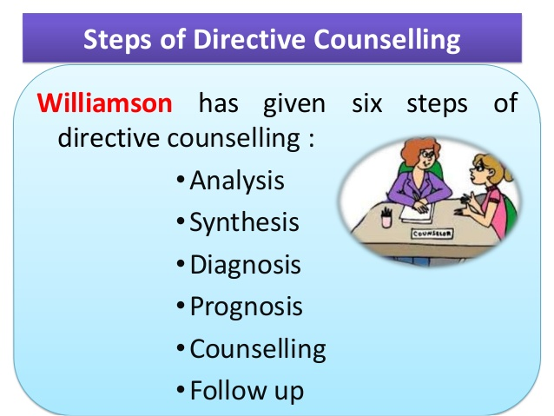
முன்கணிப்பு

Slide 5
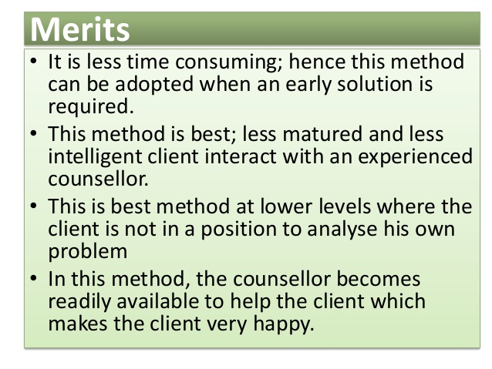

Slide 6
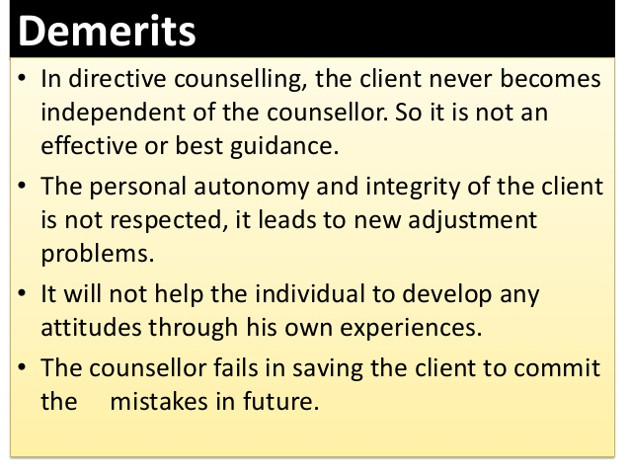

Slide 7
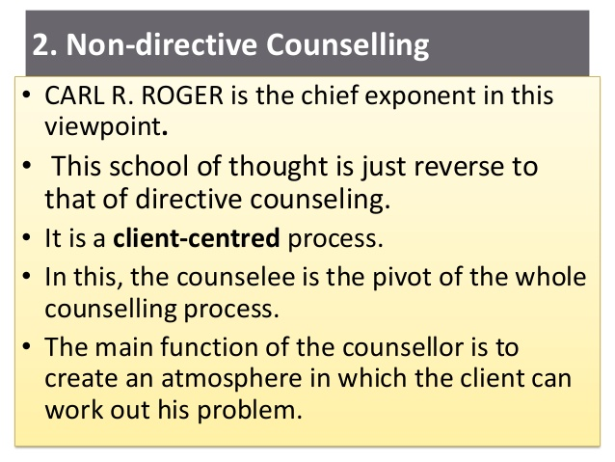

Slide 8
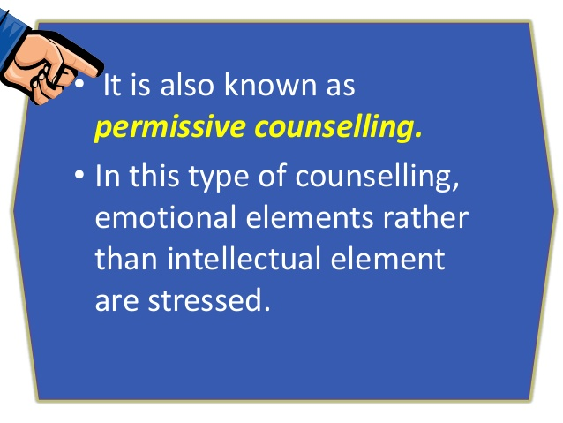

Slide 9
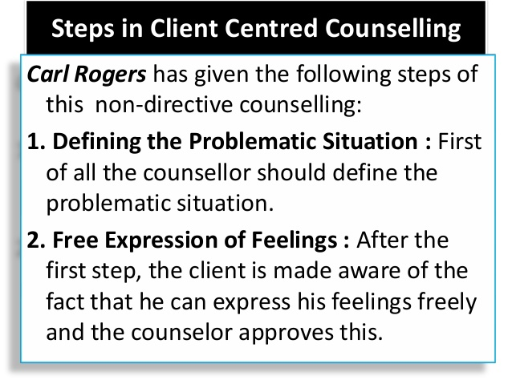

Slide 10
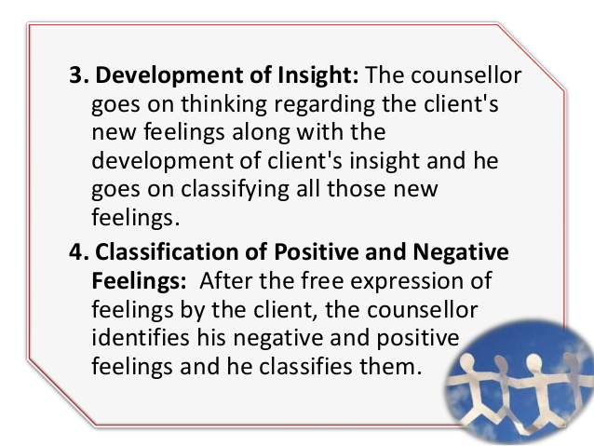

Slide 11
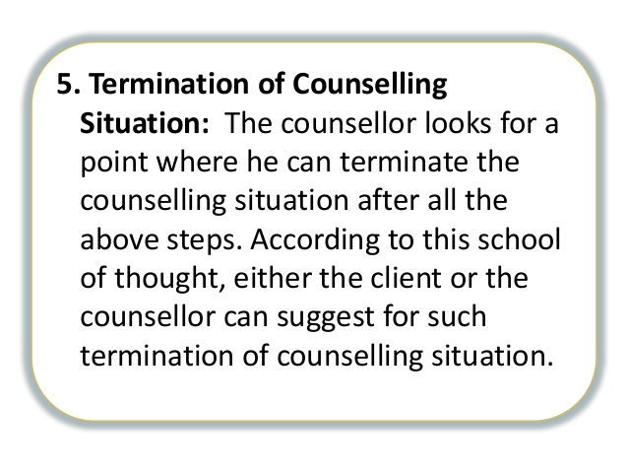

Slide 12
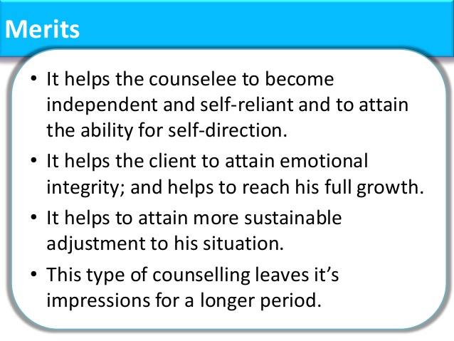

Slide 13
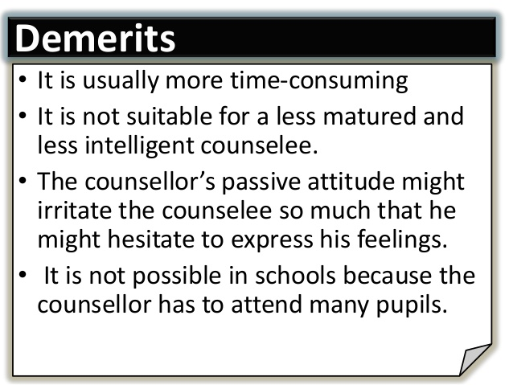

Slide 14
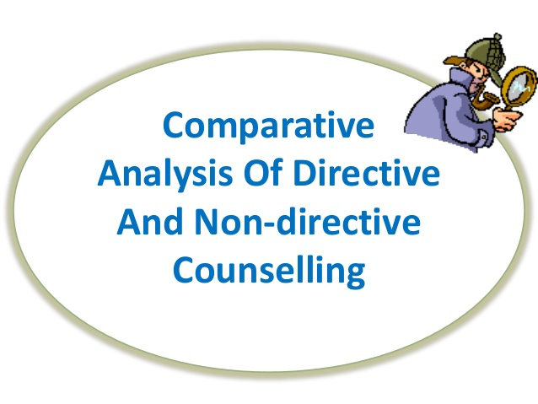

Slide 15
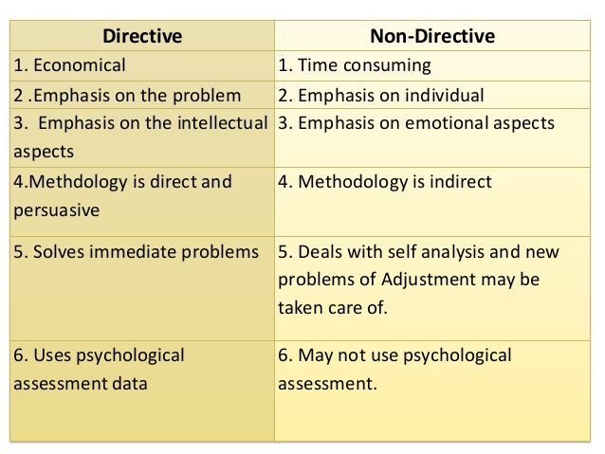

Slide 16
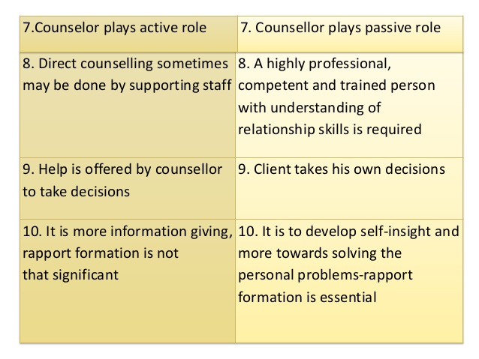
(நல்லுறவு)

Slide 17
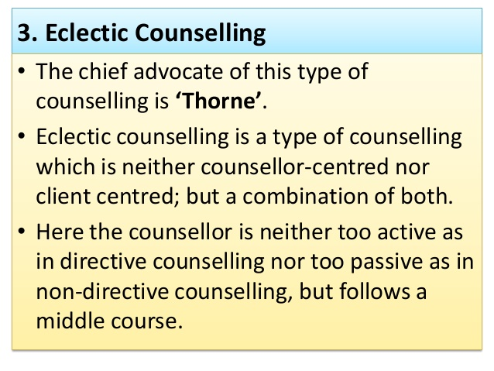

Slide 18
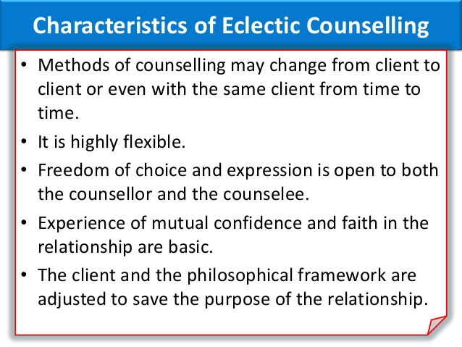

Slide 19
Counselling
Counselling falls under the umbrella term ‘talking therapies’ and allows people to discuss their problems and any difficult feelings they encounter in a safe, confidential environment.
A counsellor is not there to sit you down and tell you what to do. Instead, they will encourage you to talk about what's bothering you in order to uncover any root causes and identify your specific ways of thinking. The counsellor may then look to create a plan of action to either help you reconcile your issues, or help you to find ways of coping.

Slide 20
The qualities of a good counsellor are :
Knowledgeable
Skillful
Observant
Communication skills
Ethics and Values
Non judgemental
Empathy

Slide 21
Confidentiality
Personal integrity
Competence
Therapeutic alliance
Organized
Flexible
Open minded
Patience
Active Listening
Active Responding
Supervision
Crisis intervention
Unconditional Positive regard

